Slide 1


LOST AND FOUND
KLH LOST AND FOUND APP
ENSURING SMOOTH OPERATION AND LONGEVITY
WWW.LOSTANDFOUND.COM

Slide 2

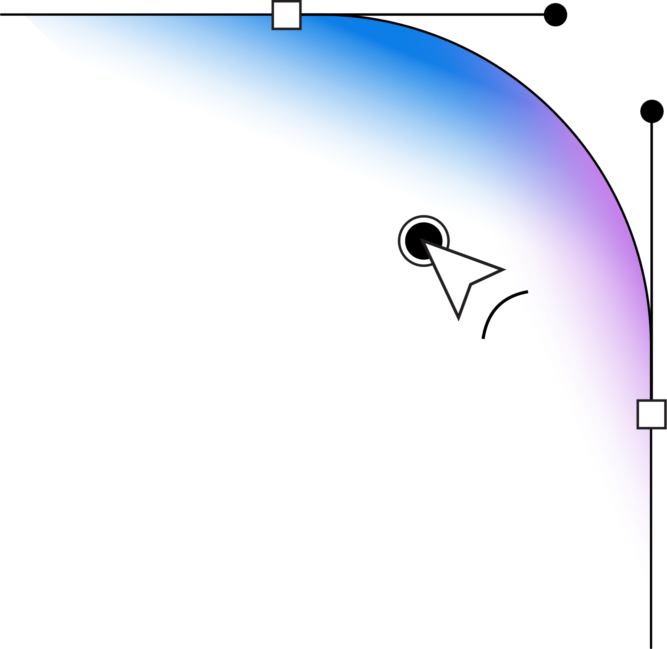

ABOUT US
Lost and Found Web Application, a platform designed to simplify the process of reporting, locating, and reclaiming lost items. The application enables users to upload images of found items, making it easier for the rightful owners to identify and claim their belongings. It also allows for detailed reporting of lost items, providing comprehensive descriptions to help others recognize and return them. Unclaimed items are placed in a timed auction, offering an opportunity for these items to find new owners if not reclaimed within a specified period. To ensure security and authenticity, users must log in using their college IDs, creating a safe environment for all participants. This comprehensive platform streamlines the management of lost and found items while ensuring a secure and user-friendly experience for everyone involved.
WWW.REALLYGREATSITE.COM

Slide 3
SURVEY OF EXISTING WEBSITES
TROOV
Limitations :
Not Widely Known: Less exposure and user base compared to your app, which could gain popularity within the college community.
Simplistic Visuals: Your app could offer a more visually appealing and user-friendly interface.
Web-Only Access: Again, limited to web-based access, while your app could provide a seamless experience across devices
https://troov.app

Slide 4
RECLAIMHUB:
Widget Embedding: Requires embedding a widget into an existing website for customer reporting, while your app offers a standalone solution.
Manual Logging: Time-consuming manual logging of reports, while your app could streamline the process with automated functionalities.
Web-Only Access: Limited to web-based access, whereas your app could be designed for better mobile responsiveness.
https://reclaimhub.com

Slide 5
LOST RETURNS:
Limited Use Cases: Focuses on specific types of losses like speculative business and racehorse maintenance, while your app serves a broader purpose.
Restrictive Carry-Forward Options: Your app's auction feature provides an innovative way to handle unclaimed items, making it more versatile.
General User Accounts: Lacks the tailored college ID-based login, making it less secure and personalized for college environments.
https://www.lostreturns.com

Slide 6
TECHNOLOGY STACK
Frontend
HTML: To structure the web pages.
CSS: To style the web pages and ensure a responsive design.
JavaScript: For interactivity and dynamic content.
Backend
Java: As the primary programming language.
Spring Boot: For building and maintaining the backend application.
Database
MongoDB: As the NoSQL database for storing user information, found items, lost items, and auction details.

Slide 7

DESIGN AND ARCHITECTURE (MVC)
Model
User: Stores user info.
Item: Stores item details (found/lost, description, image, location).
Auction: Stores auction details (item, start/end dates, bids).
View
HTML/CSS/JavaScript: Pages for login, upload found item, report lost item, view items, and auction.
Controller
User Controller: Manages user login/registration.
Item Controller: Manages found/lost item uploads and retrieval.
Auction Controller: Manages auction start and bid placement.

Slide 8
FEATURES AND FUNTIONALITY
USER AUTHENTICATION:
UPLOAD FOUND ITEM:
Login with college ID and password.
Registration (if needed).
Form to upload images, location, description, and date of found items.
Preview of uploaded image and details before submission.
REPORT LOST ITEM:
AUCTION SYSTEM:
Form to report lost items with descriptions and other relevant details.
Automatically initiate auctions for unclaimed items after a specified deadline.
Users can place bids on auction items.
Notification system for users about ongoing and upcoming auctions.

Slide 9

DEVELOPMENT WORKFLOW
SET UP
FRONTEND DEVELOPMENT
BACKEND DEVELOPMENT
TESTING AND INTEGRATION

Slide 10

ROLE AND RESPONSIBILTY
FRONTEND
SURYATEJ ,SUNANDA
BACKEND
SURYATEJ , GOVIND
DATABASE
SHREYA ,SUNANDA
DOCUMENTATION
HARSHITHA

Slide 11

THANK YOU!
WWW.REALLYGREATSITE.COM

